Slide 1
AWS
(AMAZON WEB SERVICE)

Slide 2
Analytics:
Athena
Data Pipeline
EMR
Amazon Redshift

Slide 3
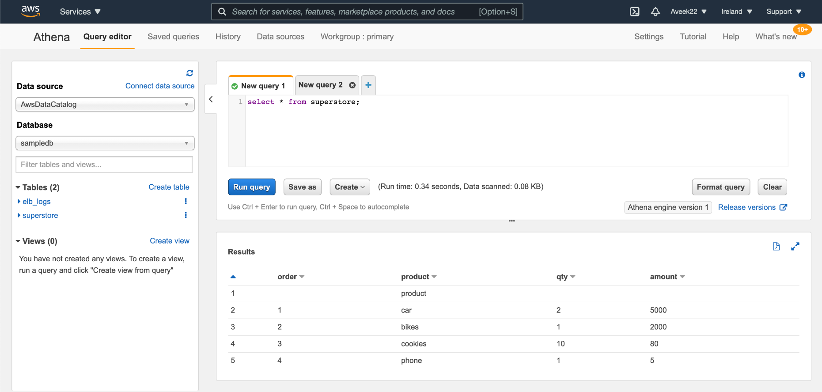
1. Athena:
Amazon Athena is an interactive data analysis tool used to process complex queries in a relatively short amount of time.
It is not a database service. Therefore, you pay for the queries you run. You just point your data into S3, define the necessary schema, and you are good to go with a standard SQL.

Slide 4
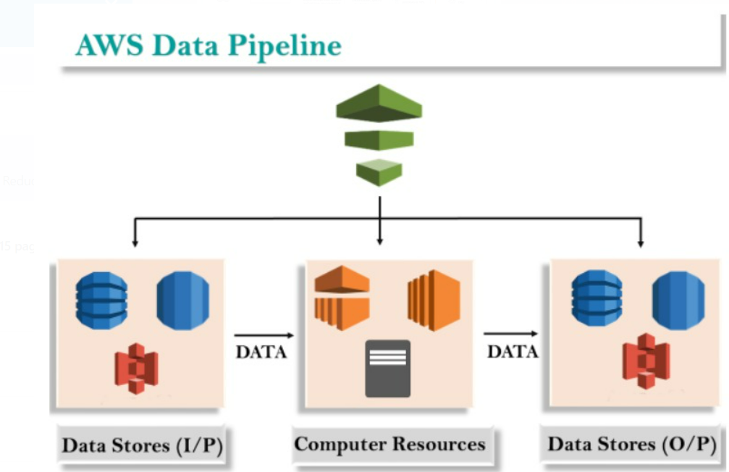
2. Data Pipeline:
AWS Data Pipeline is a web service that can access the data from different services and analyzes, processes the data at the same location, and then stores the data to different AWS services such as DynamoDB, Amazon S3.

Slide 5
3. EMR
Amazon Elastic Map Reduce (Amazon EMR) is a web service that makes it easy to process large amounts of data quickly and cost-effectively.
Amazon EMR is based on Apache Hadoop, a Java-based programming framework that supports the processing of large data sets in a distributed computing environment.
Using Map Reduce, a core component of the Hadoop software framework, developers can write programs that process massive amounts of unstructured data in distributed clusters of processors or standalone computers.

Slide 6
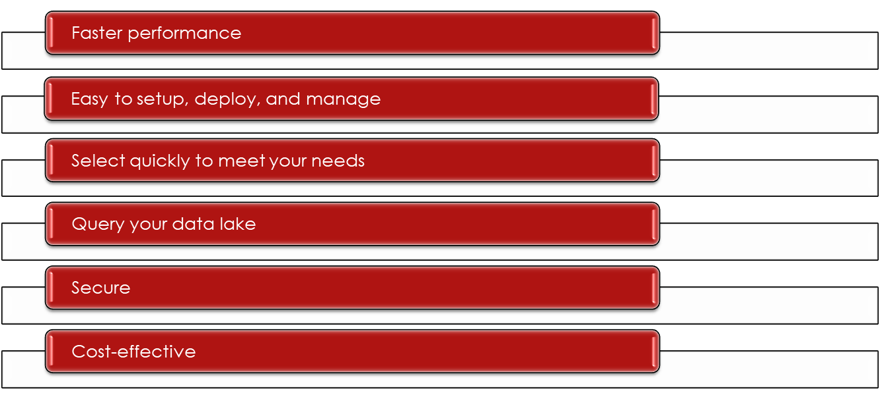
4. Amazon Redshift :
Redshift is a fast and powerful, fully managed, petabyte-scale data warehouse service in the cloud.
Amazon Redshift Features:

Slide 7
Compute:
1. EC2 :
EC2 stands for Amazon Elastic Compute Cloud. Amazon EC2 is a web service that provides resizable compute capacity in the cloud.
2. Lambda :
Lambda is a compute service where you can upload your code and create the Lambda function. Lambda takes care of provisioning and managing the servers used to run the code.
While using Lambda, you don't have to worry about scaling, patching, operating systems.

Slide 8
Database:
1. RDS (Relational Database Services)
Amazon Relational Database Service (RDS) is a managed SQL database service provided by Amazon Web Services (AWS). Amazon RDS supports structured data.
It can create database queries from database services and support all SQL commands.
We can use this database by using the query editor in Athena using “Export in amazon query ”.
RDS has a query editor but, the best way to use it is in redshift.
2. DynamoDB
Amazon DynamoDB is a fast and flexible NoSQL database service for all applications
It supports unstructured data.
Its flexible data model and performance make it a great fit for mobile, web, gaming, ad tech, IoT, and many other applications.
It is costly so most of the company avoid using this database.

Slide 9
Machine Learning:
Machine learning provides a large range of services following are a few of them:
Amazon Lex
Amazon Polly
Amazon Rekognition
Amazon Textract
Amazon SageMaker

Slide 10

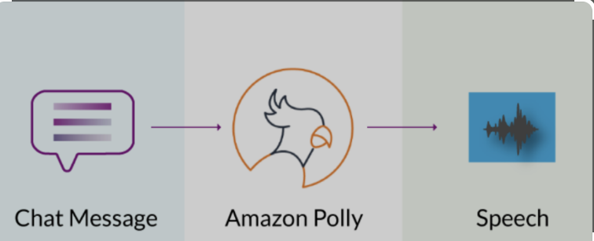
1. Amazon Lex:
Amazon Lex is a service that enables you to build highly engaging user experiences and lifelike conversational interactions.
Amazon Lex is a service for building conversational interfaces into any application using voice and text.
Amazon Lex is nothing but a chatbot, for example, Alexa, google assistance, and series.
2. Amazon Polly:
Amazon Polly uses deep learning technologies to synthesize natural-sounding human speech, so you can convert articles to speech.
Audible, kindle, and cocomelon are examples of Amazon Polly.

Slide 11

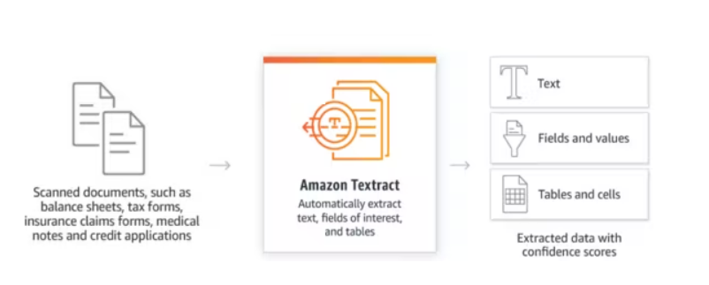
3.Amazon Rekognition:
Amazon Rekognition makes it easy to add image and video analysis to your applications using proven, highly scalable, deep learning technology that requires no machine learning expertise to use.
With Amazon Rekognition, you can identify objects, people, text, scenes, and activities in images and videos
4. Amazon Textract :
Amazon Textract helps you add document text detection and analysis to your applications. Using Amazon Textract, you can do the following:
Detect typed and handwritten text in a variety of documents, including financial reports, medical records, and tax forms.
Process ID documents such as driver’s licenses and passports can convert into text
It is similar to pytesseract.
Amazon textract more accurate and faster but costly.

Slide 12

What is AWS SageMaker?
Amazon SageMaker is a cloud-based machine-learning platform that helps users create, design, train, tune, and deploy machine-learning models in a production-ready hosted environment.

Slide 13
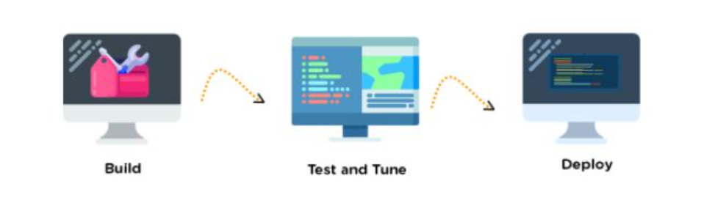
Workflow of Sagemaker
Label data
Build
Train
Tune
Deploy

Slide 14
Advantages of SageMaker:-
It enhances the productivity of a machine learning project
It helps in creating and managing compute instance with the least amount of time
It inspects raw data and automatically creates, deploys, and trains model with complete visibility
It reduces the cost of building machine learning models up to 70%
It reduces the time required for data labeling tasks
It helps in storing all ML components in one place
It is highly scalable and trains model faster
Limitation:-
The cost of sagemaker is high

Slide 15
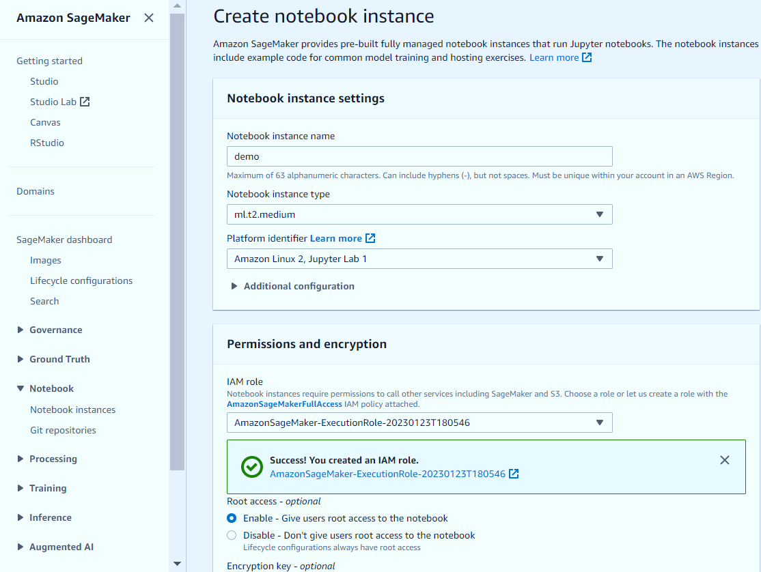
How to create Notebook instance:-

Slide 16
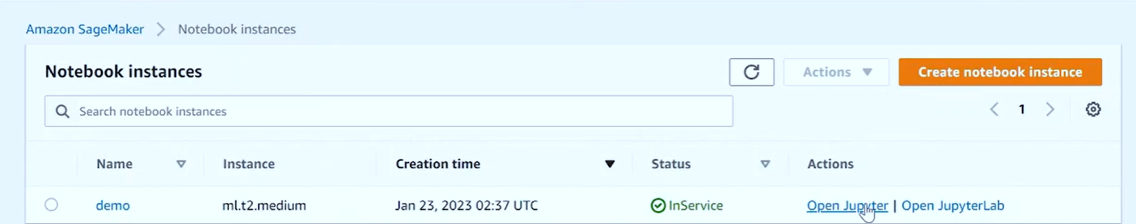
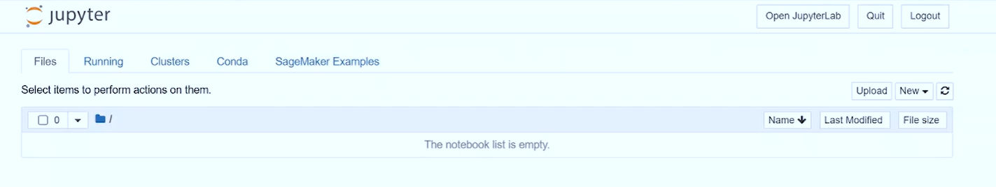
Notebook Instance

Slide 17
AMAZON S3
S3 means simple storage service
Amazon S3 provides object storage, which is built for storing and recovering any amount of information or data from anywhere over the internet.
Files are stored in Bucket.
S3 is a universal namespace.

Slide 18
Benefits and Features
Data performance and durability.
Security, compliance and auditing.
Flexible storage options
Granular data control

Slide 19
Use Cases:
Backup and restore
Disaster recovery
Archive
Data lakes and big data analytics
Hybrid cloud storage
Cloud-native application data

Slide 20
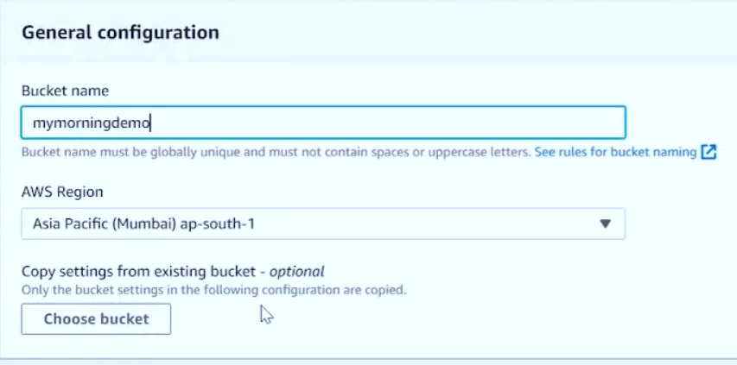
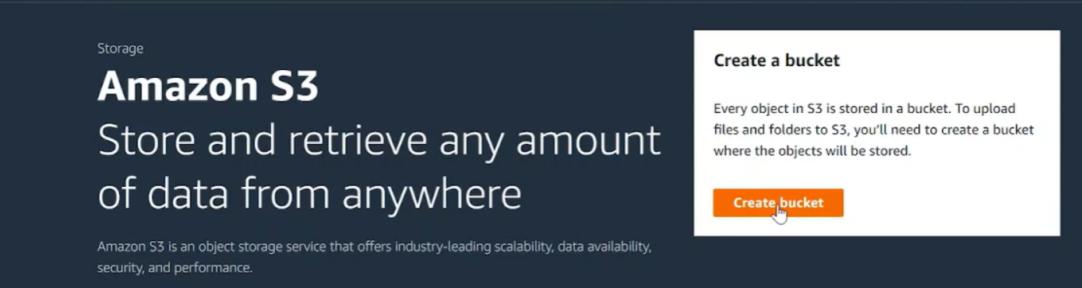
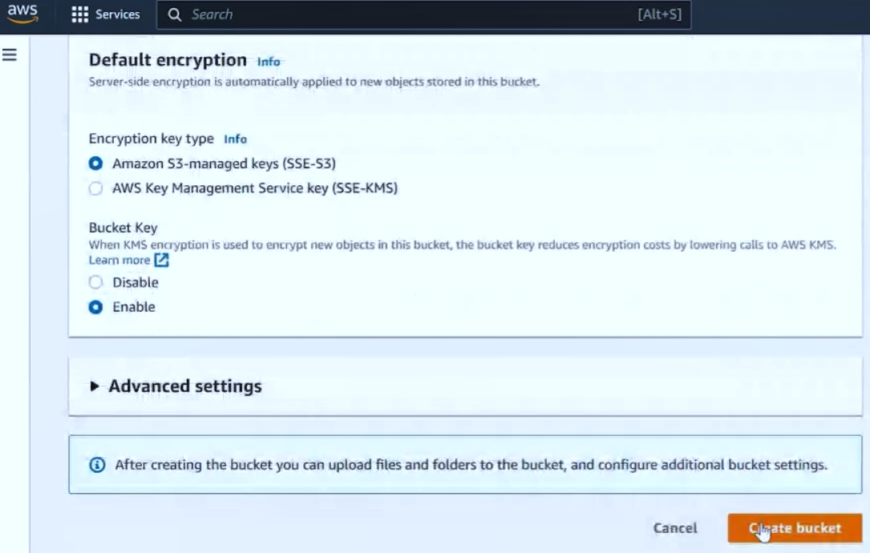
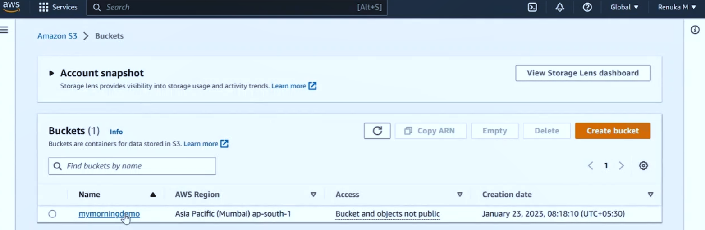
Creating an S3 Bucket:
Go to services
Click on storage
Click on S3
(2)
(1)
(3)
(4)

Slide 21
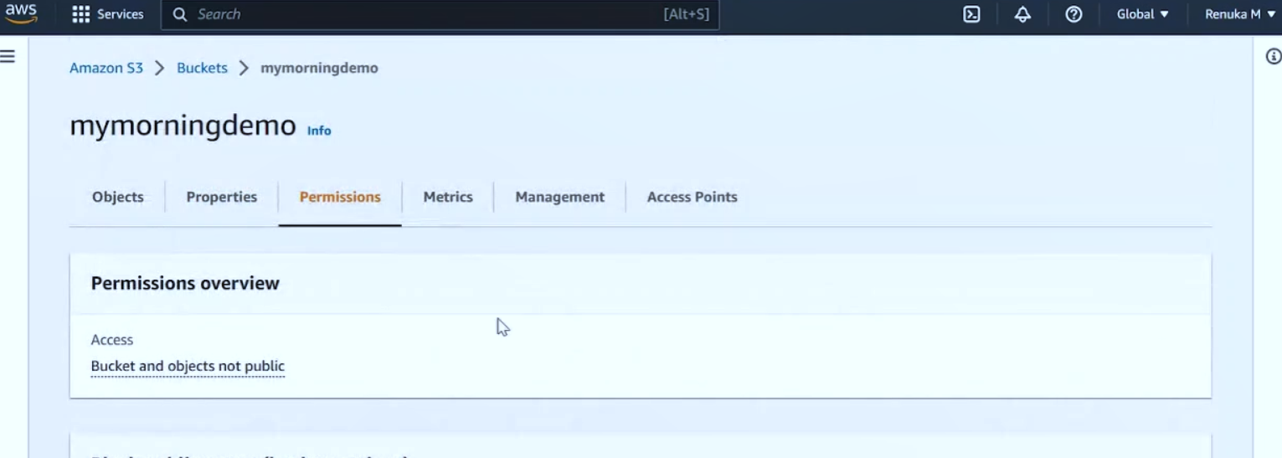
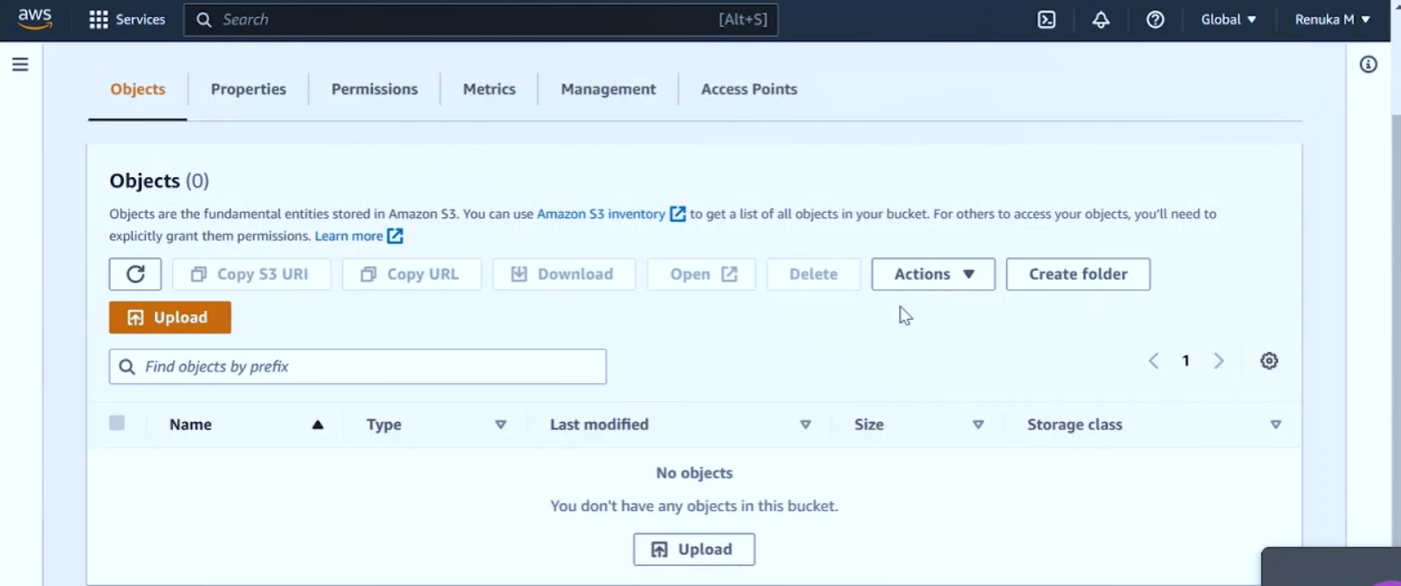
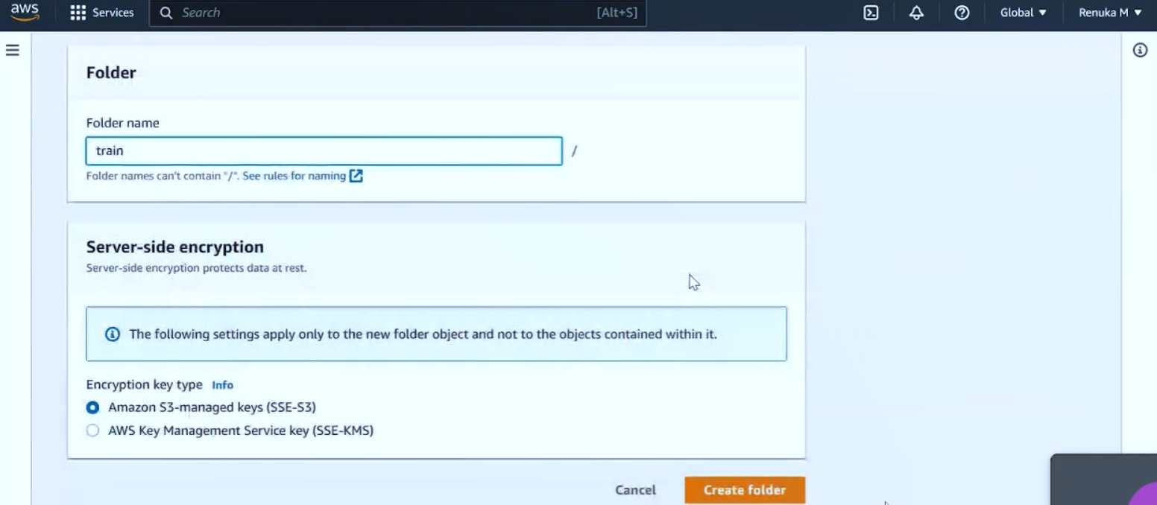
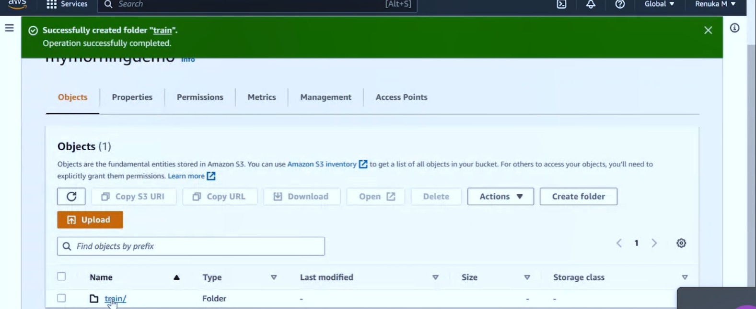
(6)
(5)
(7)
(8)

Slide 22
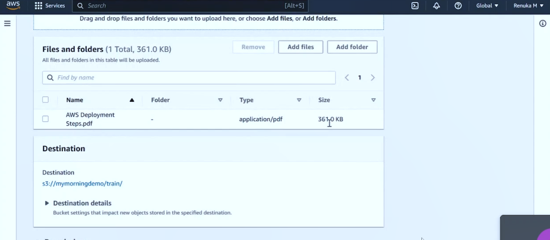
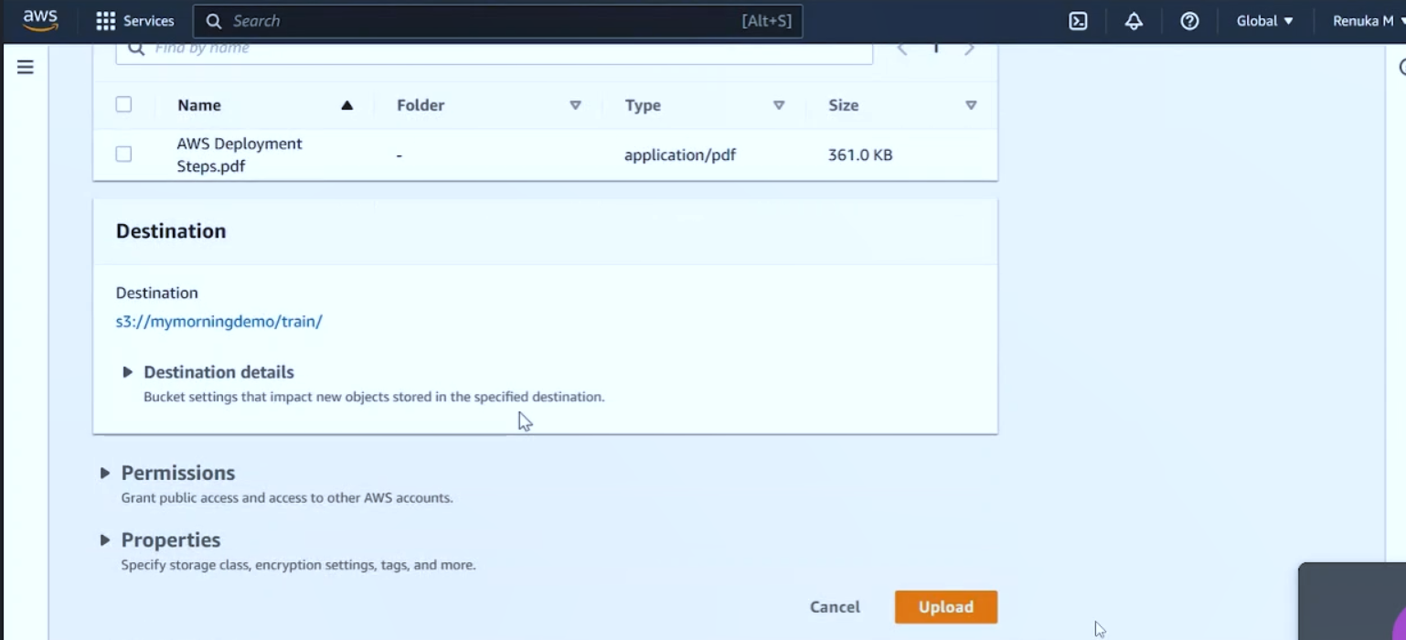
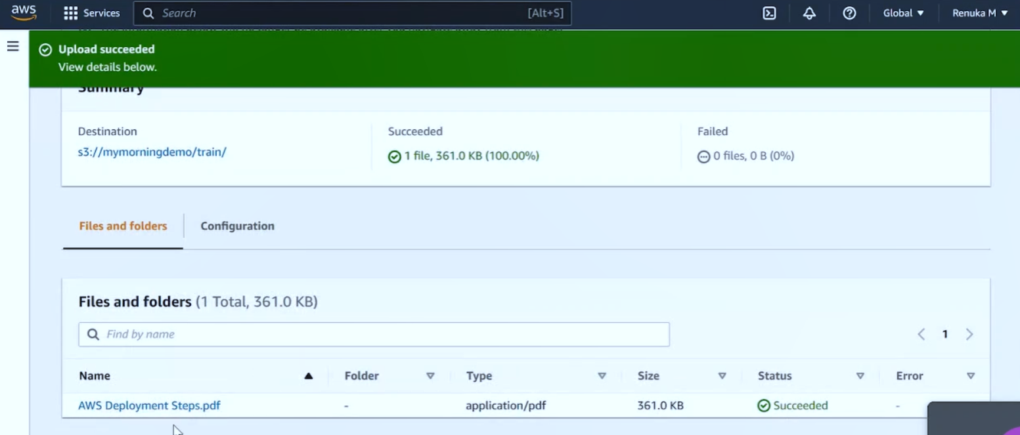
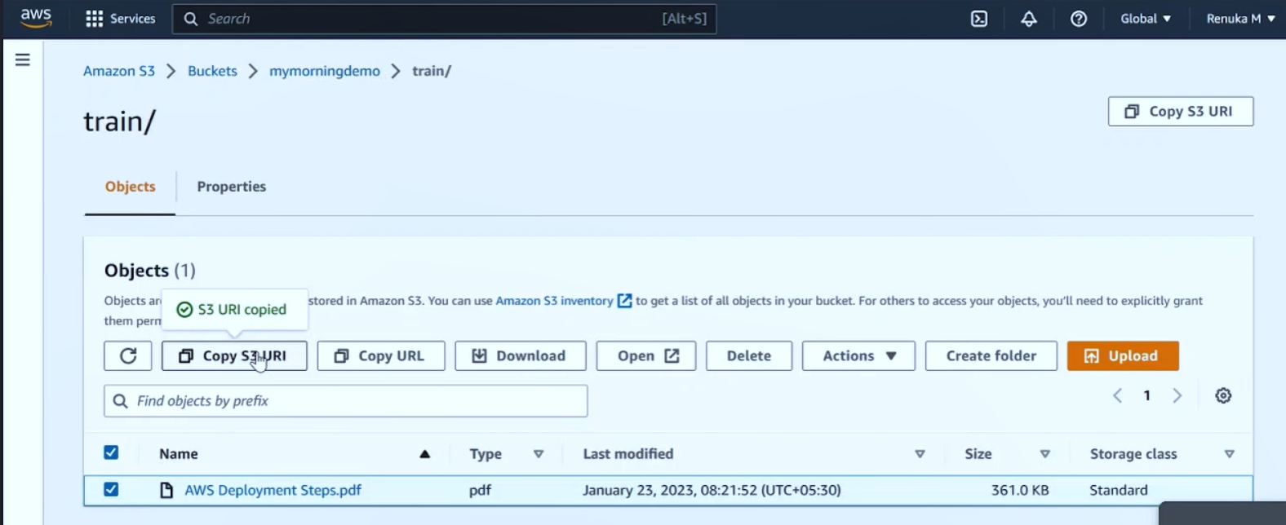
(9)
(10)
(11)
(12)

Slide 23
Conclusion:
Analytics
Compute
Database
Machine Learning
Storage

Slide 24
Thank You!

